Slide 1
Chapter 5 Module 6: EtherChannel
Switching, Routing and Wireless Essentials v7.0 (SRWE)
Notes:
Cisco Networking Academy Program Switching, Routing and Wireless Essentials v7.0 (SRWE)
Module 6: EtherChannel

Slide 2
Module Objectives
Module Title: EtherChannel
Module Objective: Troubleshoot EtherChannel on switched links.
Topic Title | Topic Objective
EtherChannel Operation | Describe EtherChannel technology.
Configure EtherChannel | Configure EtherChannel.
Verify and Troubleshoot EtherChannel | Troubleshoot EtherChannel.
Notes:
2
6.0 – Introduction
6.0.2 – What will I learn in this module?

Slide 3
6.1 EtherChannel Operation
Notes:
6- Basic Device Configuration
6.1 – EtherChannel Operation

Slide 4

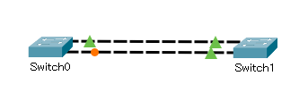
EtherChannel Operation Link Aggregation
There are scenarios in which more bandwidth or redundancy between devices is needed than what can be provided by a single link.
Multiple links could be connected between devices to increase bandwidth. However, Spanning Tree Protocol (STP), which is enabled on Layer 2 devices like Cisco switches by default, will block redundant links to prevent switching loops.
One link, no redundancy
bandwidth – 100Mbps
Multiple links, with redundancy
bandwidth – 100Mbps
STP is enabled to prevent loop
How to achieve redundancy AND
increased bandwidth?
Notes:
6 – EtherChannel
6.1 – EtherChannel Operation
6.1.1 – Link Aggregation

Slide 5


EtherChannel Operation Link Aggregation
A link aggregation technology is needed that allows redundant links between devices that will not be blocked by STP. That technology is known as EtherChannel.
EtherChannel is a link aggregation technology that groups multiple physical Ethernet links together into one single logical link. It is used to provide fault-tolerance, load sharing, increased bandwidth, and redundancy between switches, routers, and servers.
EtherChannel technology makes it possible to combine the number of physical links between the switches to increase the overall speed of switch-to-switch communication.
Multiple links, with redundancy
bandwidth – 200Mbps
Multiple links, with redundancy
bandwidth – 300Mbps
Notes:
6 – EtherChannel
6.1 – EtherChannel Operation
6.1.1 – Link Aggregation

Slide 6
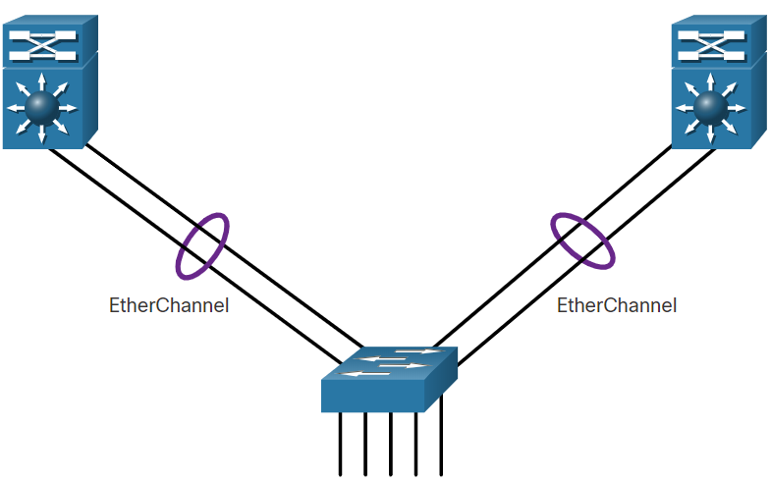
EtherChannel Operation EtherChannel
EtherChannel technology was originally developed by Cisco as a LAN switch-to-switch technique of grouping several Fast Ethernet or Gigabit Ethernet ports into one logical channel.
When an EtherChannel is configured, the resulting virtual interface is called a port channel. The physical interfaces are bundled together into a port channel interface, as shown in the figure.
Virtual interface
Interface port-channel 1
Int po 2
F0/1
F0/3
F0/2
logical channel
F0/4
F0/3
F0/1
logical channel
F0/2
F0/4
Interface port-channel 1
Int po 2
Notes:
6 – EtherChannel
6.1 – EtherChannel Operation
6.1.2 - EtherChannel

Slide 7

EtherChannel Operation Advantages of EtherChannel
EtherChannel technology has many advantages, including the following:
Most configuration tasks can be done on the EtherChannel interface instead of on each individual port, ensuring configuration consistency throughout the links.
EtherChannel relies on existing switch ports. There is the link to a faster and more expensive connection to have more bandwidth. no need to upgrade
Load balancing takes place between links that are part of the same EtherChannel.
S1 and S2
int range f0/1-2
channel-group 1 mode on
int port-channel 1
sw m trunk
sw trunk allowed vlan 10,20
S1 and S2
int range f0/1-2
sw m trunk
sw trunk allowed vlan 10,20
channel-group 1 mode on
int port-channel 1
Notes:
6 – EtherChannel
6.1 – EtherChannel Operation
6.1.3 – Advantages of EtherChannel

Slide 8
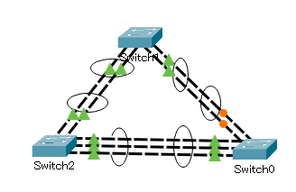
EtherChannel Operation Advantages of EtherChannel
EtherChannel creates an aggregation that is seen as one logical link. When several EtherChannel bundles exist between two switches, STP may block one of the bundles to prevent switching loops. When STP blocks one of the redundant links, it blocks the entire EtherChannel. This blocks all the ports belonging to that EtherChannel link. Where there is only one EtherChannel link, all physical links in the EtherChannel are active because STP sees only one (logical) link.
EtherChannel provides redundancy because the overall link is seen as one logical connection. Additionally, the loss of one physical link within the channel does not create a change in the topology.
Notes:
6 – EtherChannel
6.1 – EtherChannel Operation
6.1.3 – Advantages of EtherChannel

Slide 9
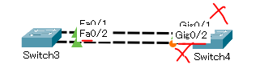

EtherChannel Operation Implementation Restrictions
EtherChannel has certain implementation restrictions, including the following:
Interface types cannot be mixed. For example, Fast Ethernet and Gigabit Ethernet cannot be mixed within a single EtherChannel.
Currently each EtherChannel can consist of up to eight compatibly-configured Ethernet ports. EtherChannel provides full-duplex bandwidth up to 800 Mbps (Fast EtherChannel) or 8 Gbps (Gigabit EtherChannel) between one switch and another switch or host.
8 Fast Ethernet cables - 800 Mbps
8 Gigabit Ethernet cables – 8 Gbps
Notes:
6 – EtherChannel
6.1 – EtherChannel Operation
6.1.4 – Implementation Restrictions

Slide 10
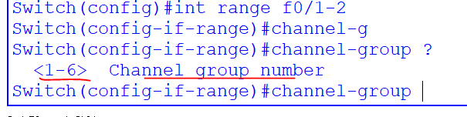
EtherChannel Operation Implementation Restrictions
EtherChannel has certain implementation restrictions, including the following:
The Cisco Catalyst 2960 Layer 2 switch currently supports up to six EtherChannels.
Notes:
6 – EtherChannel
6.1 – EtherChannel Operation
6.1.4 – Implementation Restrictions

Slide 11
EtherChannel Operation Implementation Restrictions
EtherChannel has certain implementation restrictions, including the following:
The individual EtherChannel group member port configuration must be consistent on both devices. If the physical ports of one side are configured as trunks, the physical ports of the other side must also be configured as trunks within the same native VLAN. Additionally, all ports in each EtherChannel link must be configured as Layer 2 ports.
Each EtherChannel has a logical port channel interface. A configuration applied to the port channel interface affects all physical interfaces that are assigned to that interface.
S2
int range f0/1-2
sw m access
channel-group 1 mode on
int range f0/3
sw m trunk
sw trunk allowed vlan 10,20
channel-group 1 mode on
int port-channel 1
S1
int range f0/1-2
sw m trunk
sw trunk allowed vlan 10,20
channel-group 1 mode on
int port-channel 1
Not consistence
Notes:
6 – EtherChannel
6.1 – EtherChannel Operation
6.1.4 – Implementation Restrictions

Slide 12

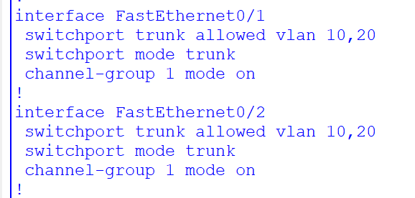
EtherChannel Operation Implementation Restrictions
EtherChannel has certain implementation restrictions, including the following:
Each EtherChannel has a logical port channel interface. A configuration applied to the port channel interface affects all physical interfaces that are assigned to that interface.
S1 and S2
int range f0/1-2
channel-group 1 mode on
int port-channel 1
sw m trunk
sw trunk allowed vlan 10,20
Notes:
6 – EtherChannel
6.1 – EtherChannel Operation
6.1.4 – Implementation Restrictions

Slide 13
EtherChannel Operation AutoNegotiation Protocols
EtherChannels can be formed through negotiation using one of two protocols, Port Aggregation Protocol (PAgP) or Link Aggregation Control Protocol (LACP). These protocols allow ports with similar characteristics to form a channel through dynamic negotiation with adjoining switches.
Note: It is also possible to configure a static or unconditional EtherChannel without PAgP or LACP.
channel-group 1 mode on
Notes:
6 – EtherChannel
6.1 – EtherChannel Operation
6.1.5 – AutoNegotiation Protocols

Slide 14
EtherChannel Operation PAgP Operation
PAgP (pronounced “Pag - P”) is a Cisco-proprietary protocol that aids in the automatic creation of EtherChannel links. When an EtherChannel link is configured using PAgP, PAgP packets are sent between EtherChannel-capable ports to negotiate the forming of a channel. When PAgP identifies matched Ethernet links, it groups the links into an EtherChannel. The EtherChannel is then added to the spanning tree as a single port.
When enabled, PAgP also manages the EtherChannel. PAgP packets are sent every 30 seconds. PAgP checks for configuration consistency and manages link additions and failures between two switches. It ensures that when an EtherChannel is created, all ports have the same type of configuration.
Note: In EtherChannel, it is mandatory that all ports have the same speed, duplex setting, and VLAN information. Any port modification after the creation of the channel also changes all other channel ports.
Notes:
6 – EtherChannel
6.1 – EtherChannel Operation
6.1.6 – PAgP Operation

Slide 15
EtherChannel Operation PAgP Operation (Cont.)
PAgP helps create the EtherChannel link by detecting the configuration of each side and ensuring that links are compatible so that the EtherChannel link can be enabled when needed. The modes for PAgP as follows:
On - This mode forces the interface to channel without PAgP. Interfaces configured in the on mode do not exchange PAgP packets.
PAgP desirable - This PAgP mode places an interface in an active negotiating state in which the interface initiates negotiations with other interfaces by sending PAgP packets.
PAgP auto - This PAgP mode places an interface in a passive negotiating state in which the interface responds to the PAgP packets that it receives but does not initiate PAgP negotiation.
The modes must be compatible on each side. If one side is configured to be in auto mode, it is placed in a passive state, waiting for the other side to initiate the EtherChannel negotiation. If the other side is also set to auto, the negotiation never starts and the EtherChannel does not form.
If all modes are disabled by using the no command, or if no mode is configured, then the EtherChannel is disabled.
The on mode manually places the interface in an EtherChannel, without any negotiation. It works only if the other side is also set to on. If the other side is set to negotiate parameters through PAgP, no EtherChannel forms, because the side that is set to on mode does not negotiate.
No negotiation between the two switches means there is no checking to make sure that all the links in the EtherChannel are terminating on the other side, or that there is PAgP compatibility on the other switch.
Notes:
6 – EtherChannel
6.1 – EtherChannel Operation
6.1.6 – PAgP Operation (Cont.)

Slide 16
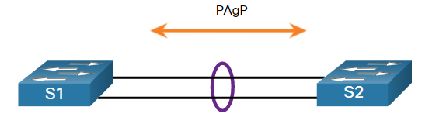
EtherChannel Operation PAgP Mode Settings Example
The table shows the various combination of PAgP modes on S1 and S2 and the resulting channel establishment outcome.
S1 | S2 | Channel Establishment
On | On | Yes
On | Desirable/Auto | No
Desirable | Desirable | Yes
Desirable | Auto | Yes
Auto | Desirable | Yes
Auto | Auto | No
Notes:
6 – EtherChannel
6.1 – EtherChannel Operation
6.1.7 – PAgP Mode Settings Example

Slide 17
EtherChannel Operation LACP Operation
LACP is part of an IEEE specification (802.3ad) that allows several physical ports to be bundled to form a single logical channel. LACP negotiate an automatic bundle by sending LACP packets to the other switch. It performs a function similar to PAgP with Cisco EtherChannel. Because LACP is an IEEE standard, it can be used to facilitate EtherChannels in multivendor environments. On Cisco devices, both protocols are supported.
LACP provides the same negotiation benefits as PAgP. LACP helps create the EtherChannel link by detecting the configuration of each side and making sure that they are compatible so that the EtherChannel link can be enabled when needed. The modes for LACP are as follows:
On - This mode forces the interface to channel without LACP. Interfaces configured in the on mode do not exchange LACP packets.
LACP active - This LACP mode places a port in an active negotiating state. In this state, the port initiates negotiations with other ports by sending LACP packets.
LACP passive - This LACP mode places a port in a passive negotiating state. In this state, the port responds to the LACP packets that it receives but does not initiate LACP packet negotiation.
Notes:
6 – EtherChannel
6.1 – EtherChannel Operation
6.1.8 – LACP Operation

Slide 18
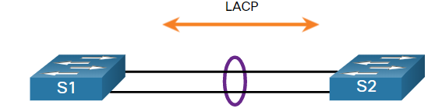
EtherChannel Operation LACP Mode Settings Example
The table shows the various combination of LACP modes on S1 and S2 and the resulting channel establishment outcome.
S1 | S2 | Channel Establishment
On | On | Yes
On | Active/Passive | No
Active | Active | Yes
Active | Passive | Yes
Passive | Active | Yes
Passive | Passive | No
Notes:
6 – EtherChannel
6.1 – EtherChannel Operation
6.1.9 – LACP Mode Settings Example
6.1.10 – Check Your Understanding – EtherChannel Operation

Slide 19
6.2 Configure EtherChannel
Notes:
6- Basic Device Configuration
6.2 – Configure EtherChannel

Slide 20
Configure EtherChannel Configuration Guidelines
The following guidelines and restrictions are useful for configuring EtherChannel:
EtherChannel support - All Ethernet interfaces must support EtherChannel with no requirement that interfaces be physically contiguous.
Speed and duplex - Configure all interfaces in an EtherChannel to operate at the same speed and in the same duplex mode.
VLAN match - All interfaces in the EtherChannel bundle must be assigned to the same VLAN or be configured as a trunk (shown in the figure).
Range of VLANs - An EtherChannel supports the same allowed range of VLANs on all the interfaces in a trunking EtherChannel. If the allowed range of VLANs is not the same, the interfaces do not form an EtherChannel, even when they are set to auto or desirable mode.
Notes:
6 – EtherChannel
6.2 – Configure EtherChannel
6.2.1 – Configuration Guidelines

Slide 21
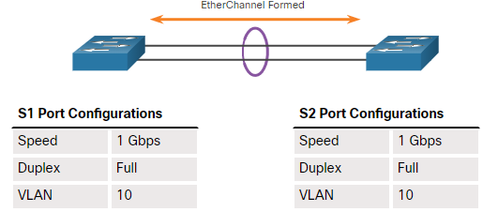
Configure EtherChannel Configuration Guidelines (Cont.)
The figure shows a configuration that would allow an EtherChannel to form between S1 and S2.
If these settings must be changed, configure them in port channel interface configuration mode. Any configuration that is applied to the port channel interface also affects individual interfaces. However, configurations that are applied to the individual interfaces do not affect the port channel interface. Therefore, making configuration changes to an interface that is part of an EtherChannel link may cause interface compatibility issues.
The port channel can be configured in access mode, trunk mode (most common), or on a routed port.
Notes:
6 – EtherChannel
6.2 – Configure EtherChannel
6.2.1 – Configuration Guidelines (Cont.)

Slide 22
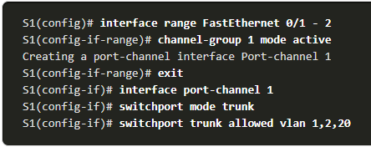
Configure EtherChannel LACP Configuration Example
Configuring EtherChannel with LACP requires the following three steps:
Step 1. Specify the interfaces that compose the EtherChannel group using the interface range interface global configuration mode command. The range keyword allows you to select several interfaces and configure them all together.
Step 2. Create the port channel interface with the channel-group identifier mode active command in interface range configuration mode. The identifier specifies a channel group number. The mode active keywords identify this as an LACP EtherChannel configuration.
Step3. To change Layer 2 settings on the port channel interface, enter port channel interface configuration mode using the interface port-channel command, followed by the interface identifier. In the example, S1 is configured with an LACP EtherChannel. The port channel is configured as a trunk interface with the allowed VLANs specified.
Notes:
6 – EtherChannel
6.2 – Configure EtherChannel
6.2.2 – LACP Configuration Example
6.2.3 – Syntax Checker – Configure EtherChannel

Slide 23
Configure EtherChannel Packet Tracer – Configure EtherChannel
In this Packet Tracer, you will complete the following objectives:
Configure Basic Switch Settings
Configure an EtherChannel with Cisco PAgP
Configure and 802.3ad EtherChannel
Configure a Redundant EtherChannel Link
Notes:
6 – EtherChannel
6.2 – Configure EtherChannel
6.2.4 – Packet Tracer – Configure EtherChannel

Slide 24
6.3 Verify and Troubleshoot EtherChannel
Notes:
6- Basic Device Configuration
6.3 – Verify and Troubleshoot EtherChannel

Slide 25
Verify and Troubleshoot EtherChannel Verify EtherChannel
As always, when you configure devices in your network, you must verify your configuration. If there are problems, you will also need to be able to troubleshoot and fix them. There are a number of commands to verify an EtherChannel configuration:
The show interfaces port-channel command displays the general status of the port channel interface.
The show etherchannel summary command displays one line of information per port channel.
The show etherchannel port-channel command displays information about a specific port channel interface.
The show interfaces etherchannel command can provide information about the role of a physical member interface of the EtherChannel.
Notes:
6 – EtherChannel
6.3 – Verify and Troubleshoot EtherChannel
6.3.1 – Verify EtherChannel

Slide 26
Verify and Troubleshoot EtherChannel Common Issues with EtherChannel Configurations
All interfaces within an EtherChannel must have the same configuration of speed and duplex mode, native and allowed VLANs on trunks, and access VLAN on access ports. Ensuring these configurations will significantly reduce network problems related to EtherChannel. Common EtherChannel issues include the following:
Assigned ports in the EtherChannel are not part of the same VLAN, or not configured as trunks. Ports with different native VLANs cannot form an EtherChannel.
Trunking was configured on some of the ports that make up the EtherChannel, but not all of them. It is not recommended that you configure trunking mode on individual ports that make up the EtherChannel. When configuring a trunk on an EtherChannel, verify the trunking mode on the EtherChannel.
If the allowed range of VLANs is not the same, the ports do not form an EtherChannel even when PAgP is set to the auto or desirable mode.
The dynamic negotiation options for PAgP and LACP are not compatibly configured on both ends of the EtherChannel.
Notes:
6 – EtherChannel
6.3 – Verify and Troubleshoot EtherChannel
6.3.2 – Common Issues with EtherChannel Configurations

Slide 27

Verify and Troubleshoot EtherChannel Troubleshoot EtherChannel Example
In the figure, interfaces F0/1 and F0/2 on switches S1 and S2 are connected with an EtherChannel. However, the EtherChannel is not operational.
Notes:
6 – EtherChannel
6.3 – Verify and Troubleshoot EtherChannel
6.3.3 – Troubleshoot EtherChannel Example

Slide 28
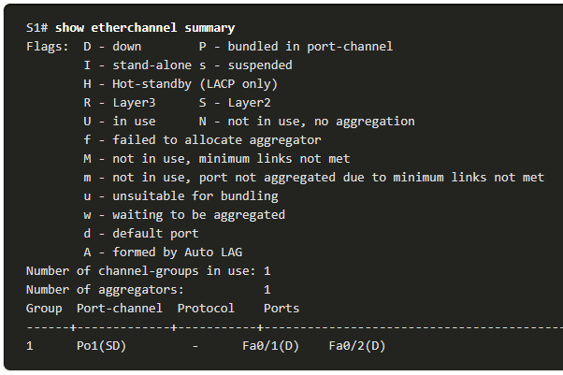
Verify and Troubleshoot EtherChannel Troubleshoot EtherChannel Example (Cont.)
Step 1. View the EtherChannel Summary Information: The output of the show etherchannel summary command indicates that the EtherChannel is down.
Notes:
6 – EtherChannel
6.3 – Verify and Troubleshoot EtherChannel
6.3.3 – Troubleshoot EtherChannel Example (Cont.)

Slide 29
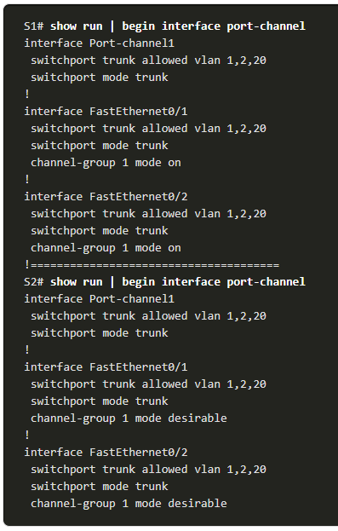
Verify and Troubleshoot EtherChannel Troubleshoot EtherChannel Example (Cont.)
Step 2. View Port Channel Configuration: In the show run | begin interface port-channel output, more detailed output indicates that there are incompatible PAgP modes configured on S1 and S2.
Notes:
6 – EtherChannel
6.3 – Verify and Troubleshoot EtherChannel
6.3.3 – Troubleshoot EtherChannel Example (Cont.)

Slide 30
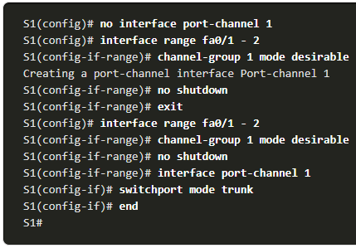
Verify and Troubleshoot EtherChannel Troubleshoot EtherChannel Example (Cont.)
Step 3: Correct the Misconfiguration: To correct the issue, the PAgP mode on the EtherChannel is changed to desirable.
Note: EtherChannel and STP must interoperate. For this reason, the order in which EtherChannel-related commands are entered is important, which is why you see interface Port-Channel 1 removed and then re-added with the channel-group command, as opposed to directly changed. If one tries to change the configuration directly, STP errors cause the associated ports to go into blocking or errdisabled state.
Notes:
6 – EtherChannel
6.3 – Verify and Troubleshoot EtherChannel
6.3.3 – Troubleshoot EtherChannel Example (Cont.)

Slide 31
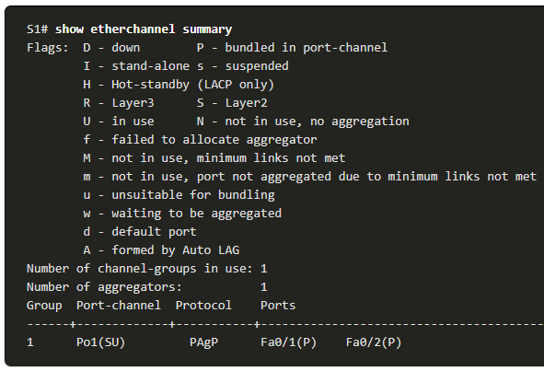
Verify and Troubleshoot EtherChannel Troubleshoot EtherChannel Example (Cont.)
Step 4. Verify EtherChannel is Operational: The EtherChannel is now active as verified by the output of the show etherchannel summary command.
Notes:
6 – EtherChannel
6.3 – Verify and Troubleshoot EtherChannel
6.3.3 – Troubleshoot EtherChannel Example (Cont.)

Slide 32
Verify and Troubleshoot EtherChannel Packet Tracer – Troubleshoot EtherChannel
In this Packet Tracer, you will complete the following:
Examine the Physical Layer and Correct Switch Port Mode Issues
Identify and Correct Port Channel Assignment Issues
Identify and Correct Port Channel Assignment Issues
Notes:
6 – EtherChannel
6.3 – Verify and Troubleshoot EtherChannel
6.3.4 – Packet Tracer – Troubleshoot EtherChannel

Slide 33
6.4 Module Practice and Quiz
Notes:
6- Basic Device Configuration
6.4 – Module Practice and Quiz

Slide 34
Module Practice and Quiz Packet Tracer – Implement EtherChannel
In this Packet Tracer, you will complete the following:
Build the Network
Configure EtherChannel
Notes:
6 – EtherChannel
6.4 – Module Practice and Quiz
6.4.1 – Packet Tracer – Implement EtherChannel

Slide 35
Module Practice and Quiz Lab – Implement EtherChannel
In this lab, you will complete the following objectives:
Part 1: Build the Network and Configure Basic Device Settings
Part 2: Create VLANs and Assign Switch Ports
Part 3: Configure 802.1Q Trunks between the Switches
Part 4: Implement and Verify an EtherChannel between the switches
Notes:
6 – EtherChannel
6.4 – Module Practice and Quiz
6.4.2 – Lab – Implement EtherChannel

Slide 36
Module Practice and Quiz What Did I Learn In This Module?
To increase bandwidth or redundancy, multiple links could be connected between devices. However, STP will block redundant links to prevent switching loops. EtherChannel is a link aggregation technology that allows redundant links between devices that will not be blocked by STP.
EtherChannel groups multiple physical Ethernet links together into one single logical link. It provides fault-tolerance, load sharing, increased bandwidth, and redundancy between switches, routers, and servers.
When an EtherChannel is configured, the resulting virtual interface is called a port channel.
EtherChannels can be formed through negotiation using one of two protocols, PAgP or LACP. These protocols allow ports with similar characteristics to form a channel through dynamic negotiation with adjoining switches.
When an EtherChannel link is configured using Cisco-proprietary PAgP, PAgP packets are sent between EtherChannel-capable ports to negotiate the forming of a channel. Modes for PAgP are On, PAgP desirable, and PAgP auto.
LACP performs a function similar to PAgP with Cisco EtherChannel. Because LACP is an IEEE standard, it can be used to facilitate EtherChannels in multivendor environments. Modes for LACP are On, LACP active, and LACP passive.
Notes:
6 – EtherChannel
6.4 – Module Practice and Quiz
6.4.3 – What Did I Learn In This Module?

Slide 37
Module Practice and Quiz What Did I Learn In This Module? (Cont.)
The following guidelines and restrictions are useful for configuring EtherChannel:
All Ethernet interfaces on all modules must support EtherChannel with no requirement that interfaces be physically contiguous, or on the same module.
Configure all interfaces in an EtherChannel to operate at the same speed and in the same duplex mode.
All interfaces in the EtherChannel bundle must be assigned to the same VLAN or be configured as a trunk.
An EtherChannel supports the same allowed range of VLANs on all the interfaces in a trunking EtherChannel.
Configuring EtherChannel with LACP requires three steps:
Step 1. Specify the interfaces that compose the EtherChannel group using the interface range interface global configuration mode command.
Step 2. Create the port channel interface with the channel-group identifier mode active command in interface range configuration mode.
Step 3. To change Layer 2 settings on the port channel interface, enter port channel interface configuration mode using the interface port-channel command, followed by the interface identifier.
Notes:
6 – EtherChannel
6.4 – Module Practice and Quiz
6.4.3 – What Did I Learn In This Module? (Cont.)

Slide 38
Module Practice and Quiz What Did I Learn In This Module? (Cont.)
There are a number of commands to verify an EtherChannel configuration including show interfaces port-channel, show etherchannel summary, show etherchannel port-channel, and show interfaces etherchannel.
Common EtherChannel issues include the following:
Assigned ports in the EtherChannel are not part of the same VLAN, or not configured as trunks.
Ports with different native VLANs cannot form an EtherChannel.
Trunking was configured on some of the ports that make up the EtherChannel, but not all of them.
If the allowed range of VLANs is not the same, the ports do not form an EtherChannel even when PAgP is set to the auto or desirable mode.
The dynamic negotiation options for PAgP and LACP are not compatibly configured on both ends of the EtherChannel.
Notes:
6 – EtherChannel
6.4 – Module Practice and Quiz
6.4.3 – What Did I Learn In This Module? (Cont.)
6.4.4 – Module Quiz - EtherChannel

Slide 39
Module 6: EtherChannel New Terms and Commands
Link Aggregation
EtherChannel
Port Channel
Port Aggregation Protocol (PAgP)
Link Aggregation Control Protocol (LACP)
PAgP desirable
PAgP auto
LACP active
LACP passive
channel-group X mode [ desirable | auto | active | passive ]
interface port-channel X
show interfaces port-channel
show etherchannel summary
show etherchannel port-channel
show interfaces etherchannel

